Slide 1

What is PowerBI?
Visualization Layer
BI semantic model or end user data model
Data Preparation

Slide 2
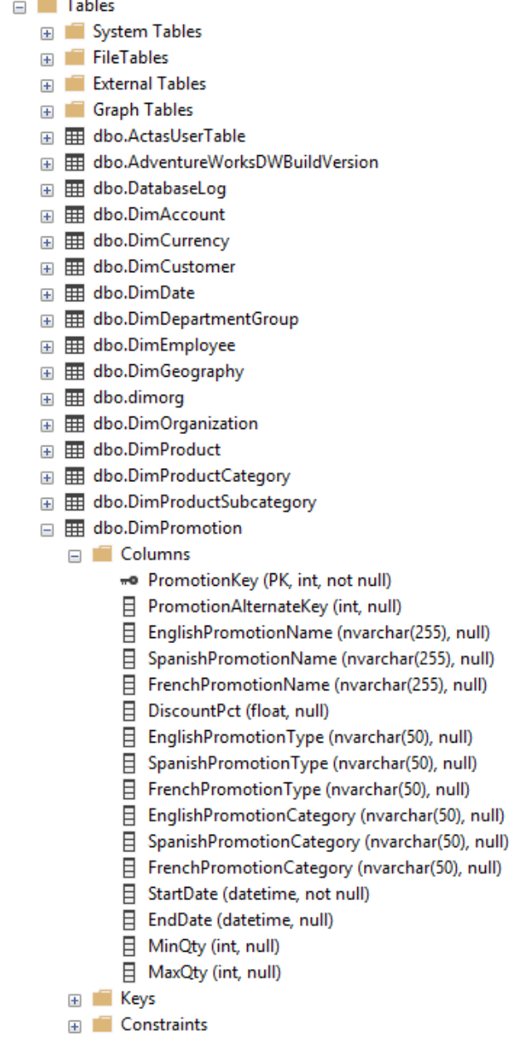
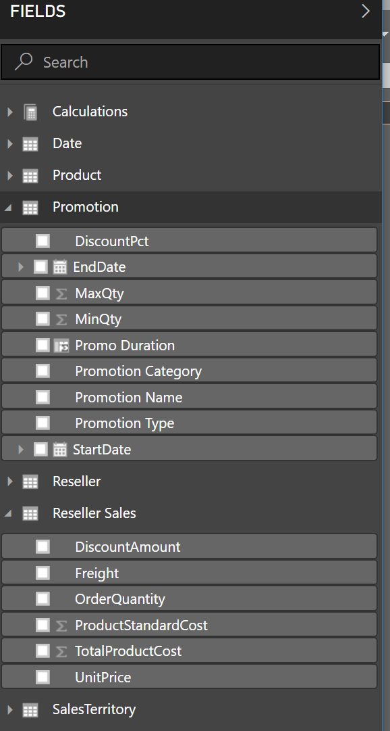
The Semantic or End user model is what the user sees in Power BI
Users can see this – easy to read
Or this – underlying database tables and columns
The data model can:
Rename fields
Hide fields or tables
Add calculations and derive data
Add relationships to improve navigation

Slide 3


The Semantic or End user model is what the user sees in Power BI
Some data engines bring their own data model (SAP BW, HANA, Analysis Services)
PBI can import data from many, many sources (100 or so)
PBI can add a semantic model without moving the data

Slide 4
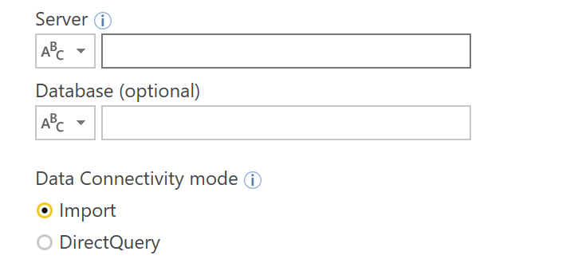

Import mode
All Data Sources
1 or more data sources
All functionality
1 gigabyte file limit in PBI Service
Larger with Premium
Use:
Personal and Team solutions
Prototypes
Repeatable processes
Removing Excel Hell

Slide 5





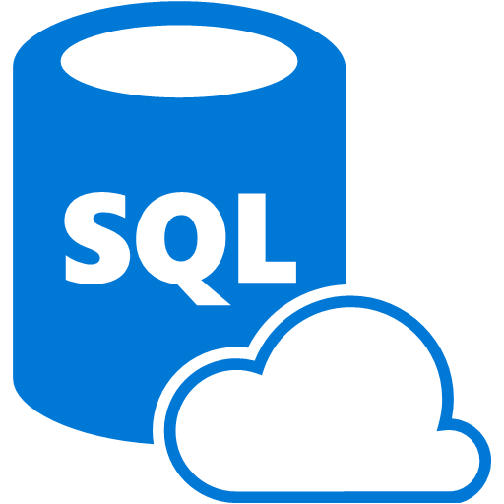




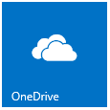

Usage of PBI - Import and merge data
SaaS Data Sources
Azure-resident systems
PBI Designer
Powerbi.com
Azure SQL
Azure Stream Analytics
Data imported and cached in an in-memory database
HDInsight
On-premise systems / other
Enterprise Data Gateway
SQL
Corporate Data Sources
Notes:
Here data pulled from on premise sources using the gateway – a server that handles traffic from onpremise to azure service fabric without opening incoming firewall ports

Slide 6
Usage of PBI - Direct Query
SaaS Data Sources
Redshift
SnowFlake
Azure-resident systems
Azure SQL
PBI Designer
Powerbi.com
Azure Stream Analytics
Metadata but no actual data is stored
HDInsight
On-premise systems / other
Enterprise Data Gateway
SQL
Corporate Data Sources

Slide 7
Usage of PBI - Live Query
Azure-resident systems
PBI Designer
Powerbi.com
Azure Analysis Services
Query against data model
On-premise systems / other
Enterprise Data Gateway
SQL Server Analysis Services
SAP BW and HANA

